Slide 1
Efficiency of Public Expenditure on Education—OECD Countries
ETM540-Group Project
Andey Nunes
Aparna raghuram
Jordan Hilton
Mohamed Sheikh
Samira Akhter

Slide 2
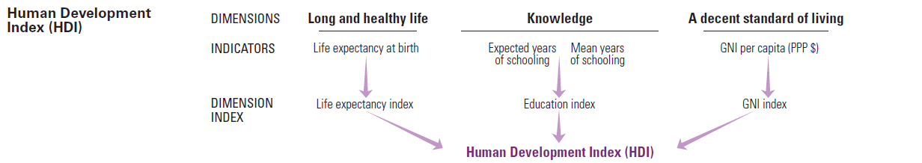
Background
Education is considered the backbone of any developed society and it’s a vital component of all in calculating the HDI

Slide 3
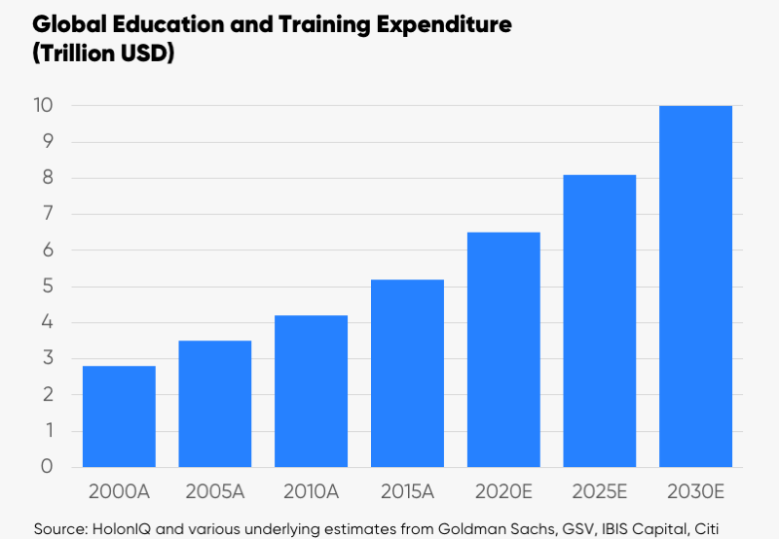
Current and projected Global Spending on education
Notes:
https://www.holoniq.com/2030/
http://www.holoniq.com/wp-content/uploads/2018/06/HolonIQ-Education-in-2030.pdf

Slide 4
Global Industry Needs
Standards for Measuring performance
Reliable data collecting agencies.
Benchmarking relative efficiencies in spending

Slide 5
PISA
Programme for International Student Assessment
Measures 15 year old on performance in Science, Math and Reading.
Every 3 years
PISA has been performing these assessmentS since 2000 and published data is available to all countries.

Slide 6
Project Scope
Use the latest available PISA data (2015) to benchmark educational efficiencies of OECD countries.
Extend efficiencies to determine how best to distribute additional money to improve overall performance.
Technique Utilized for this project
DEA
Linear Programming with sensitivity Analysis

Slide 7
Our Variables
Average PISA performance scores (Science, Reading and Mathematics.
Total Spending per student in dollars
Overall Spending as percentage of GDP

Slide 8
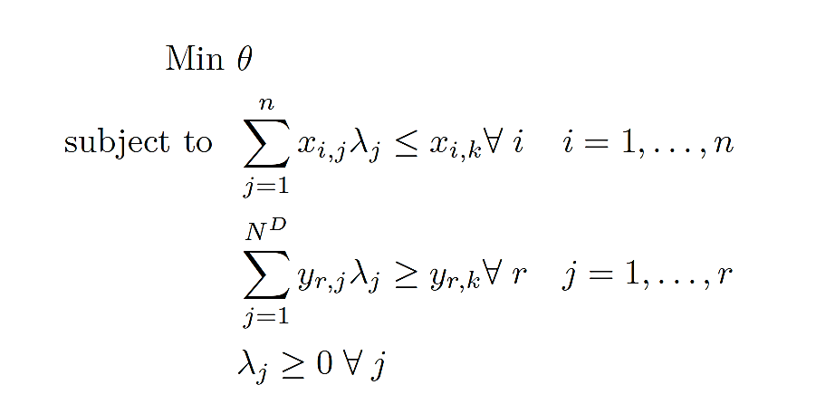
DEA Analysis
Output Oriented model.
Variable returns to scale

Slide 9
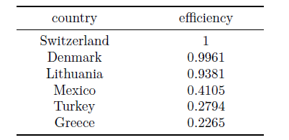

Slide 10
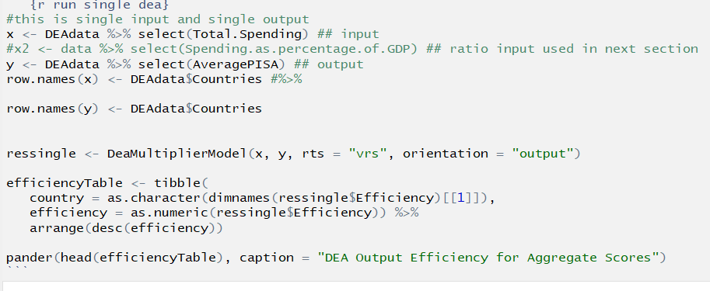
Implementation of the Model

Slide 11
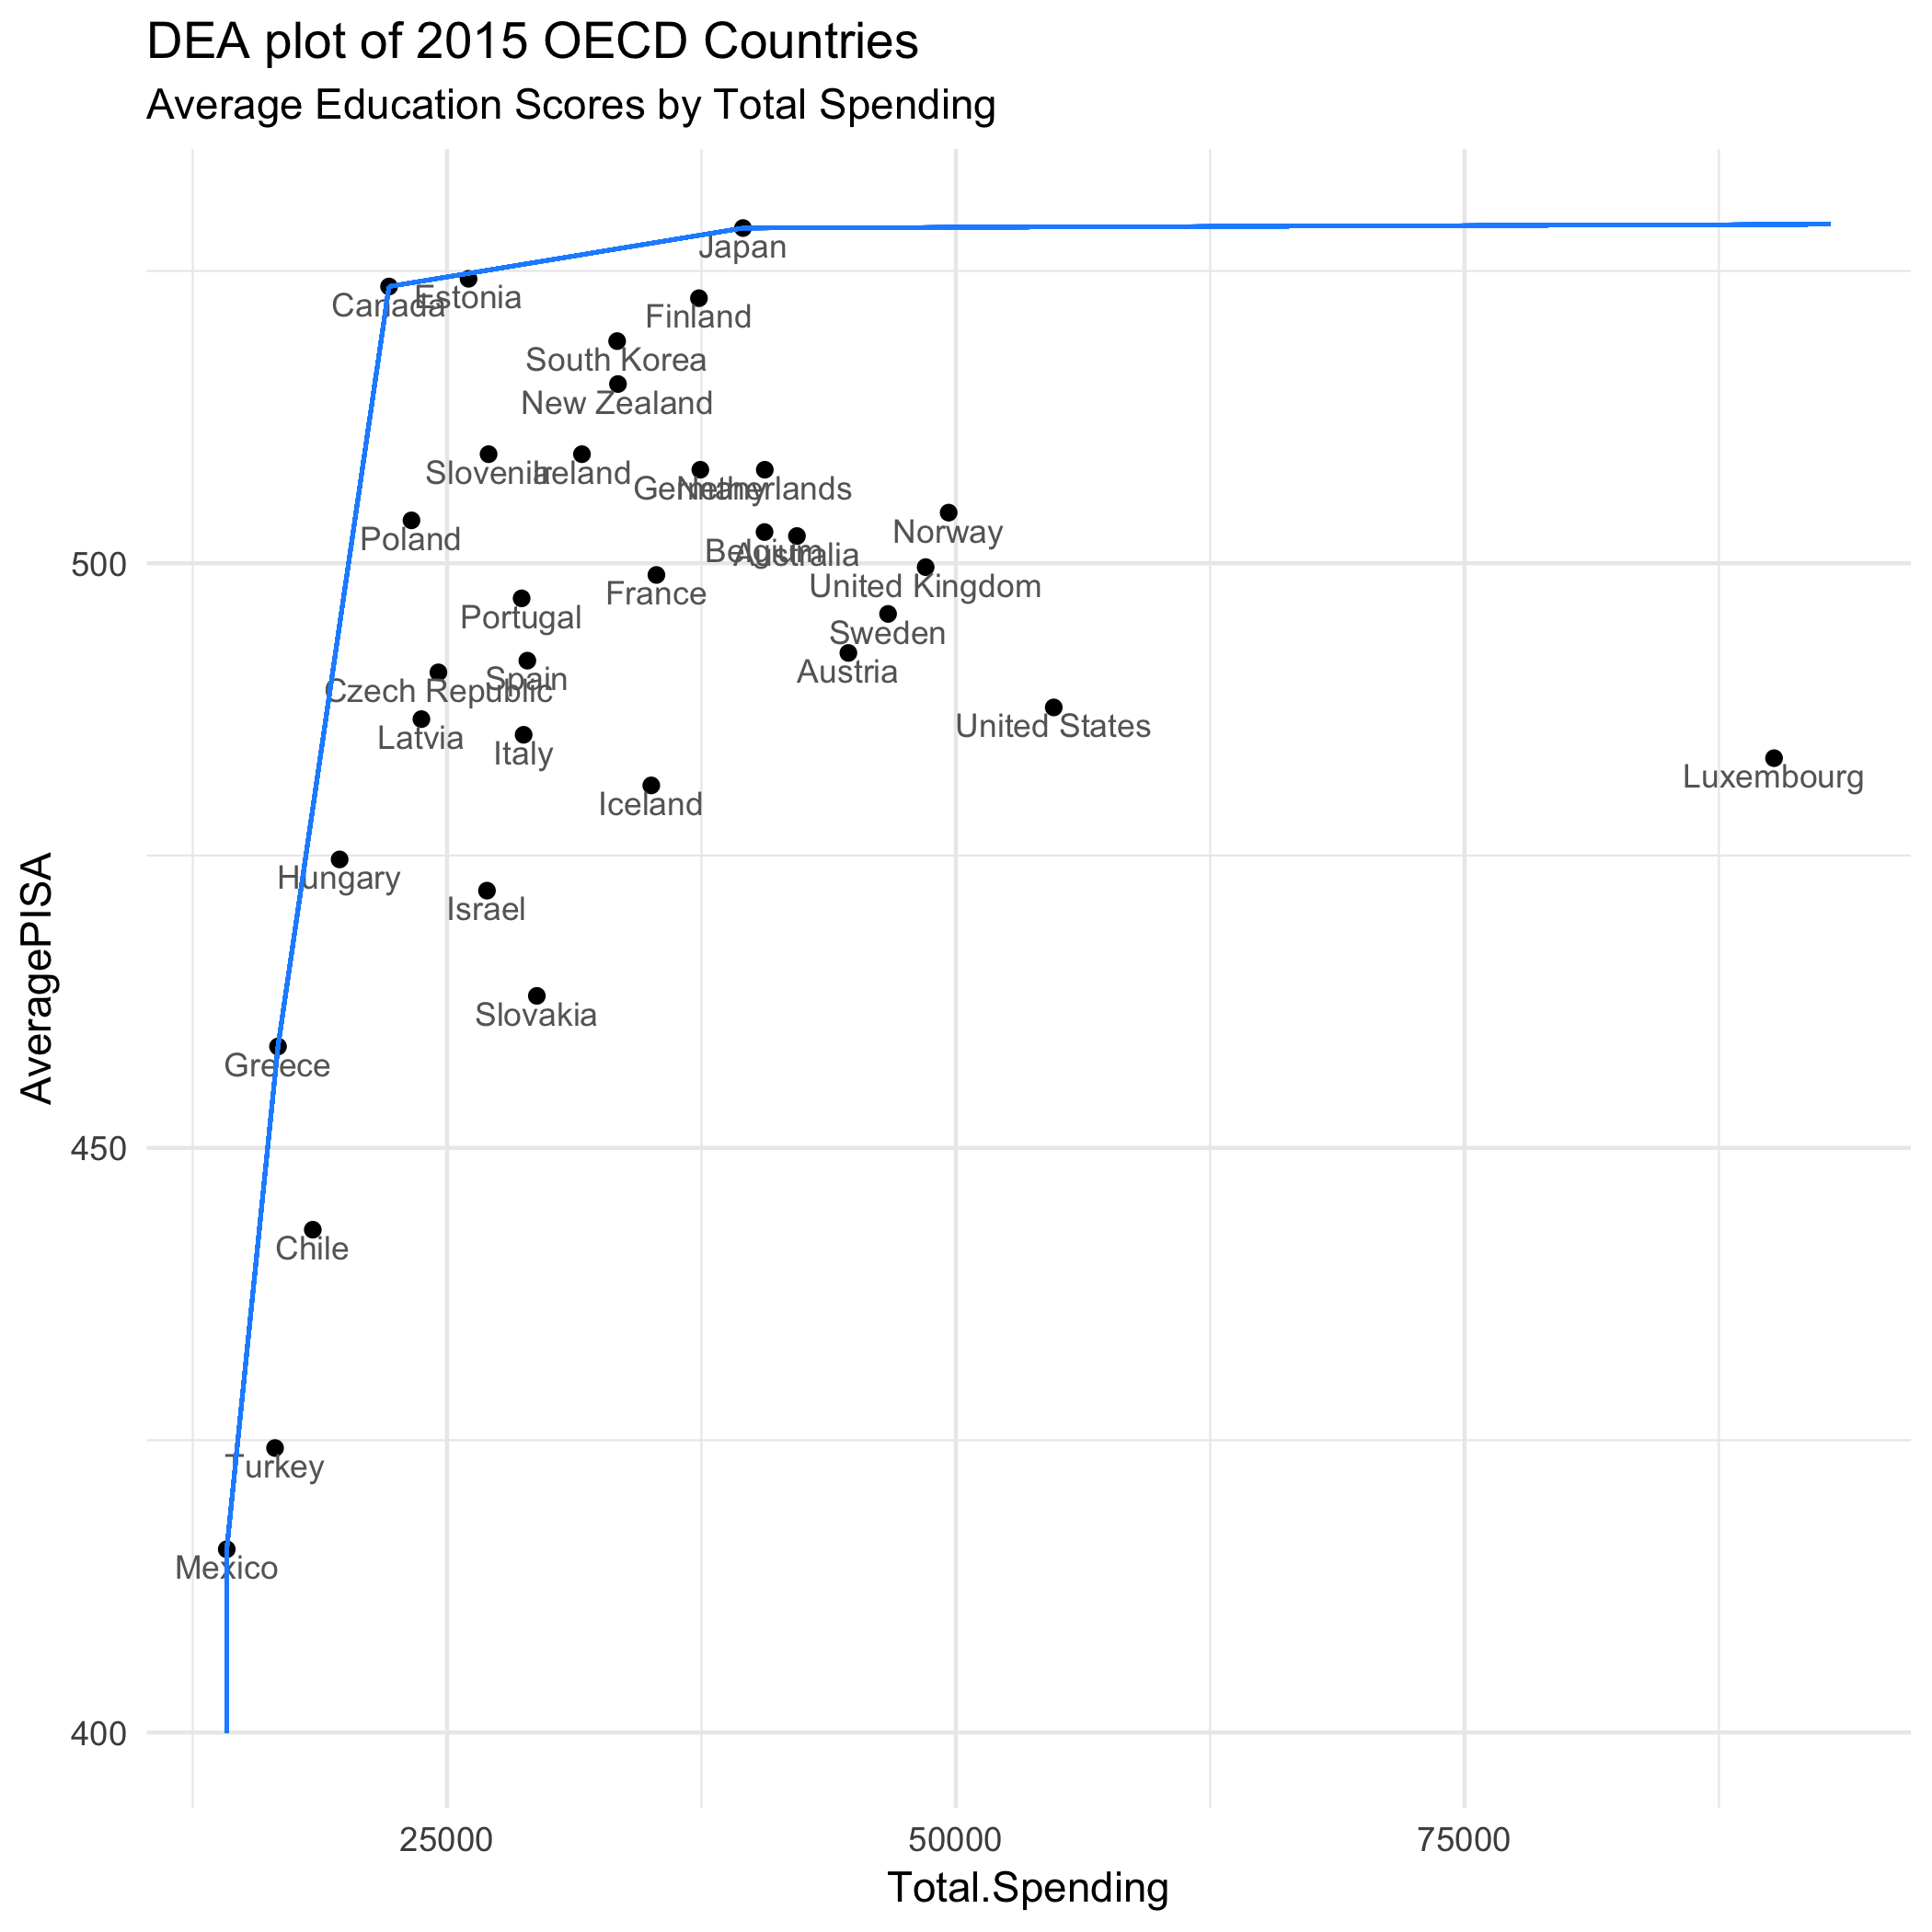
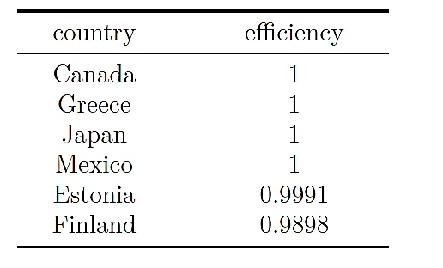
Results—Efficiency Scores

Slide 12
Results--Benchmarking

Slide 13
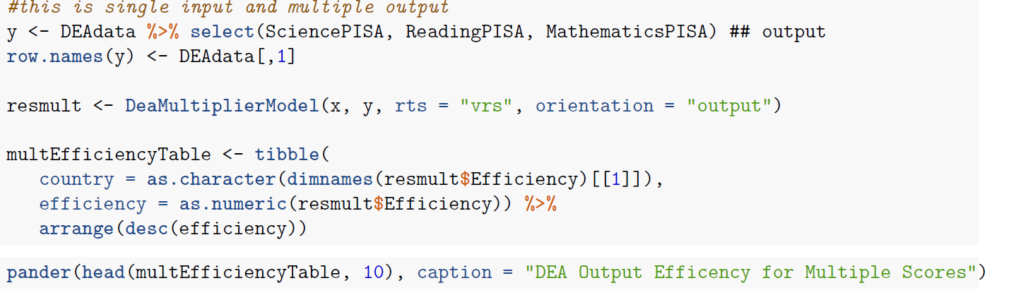
Multiple Output—Model Implementation

Slide 14
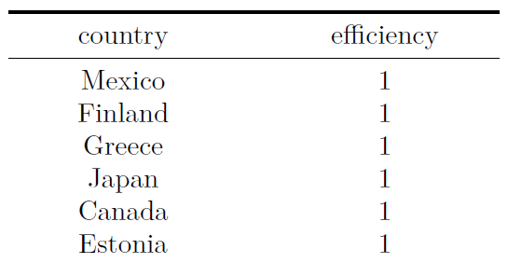
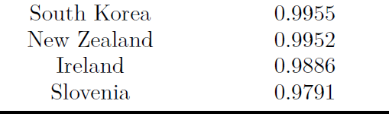
Multiple Outputs—Results (Efficiencies)

Slide 15
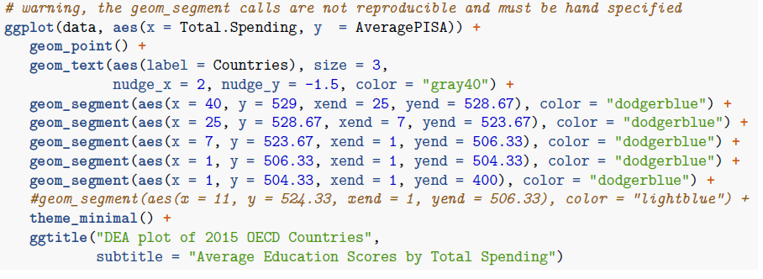
Previous graph was little convoluted, lets use ggplot

Slide 16
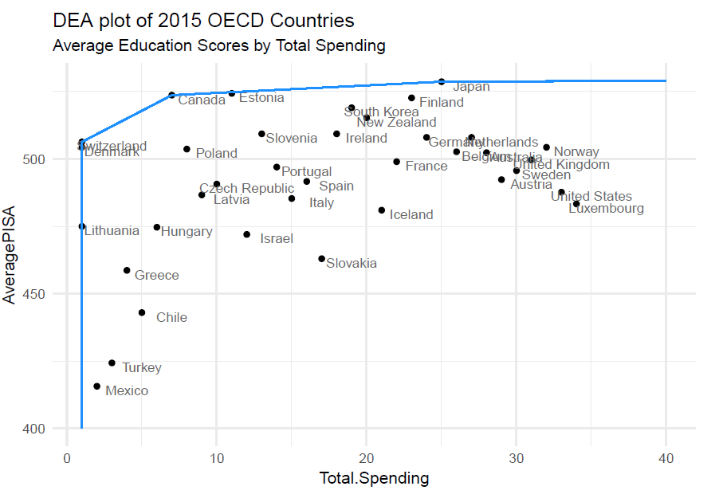

Slide 17
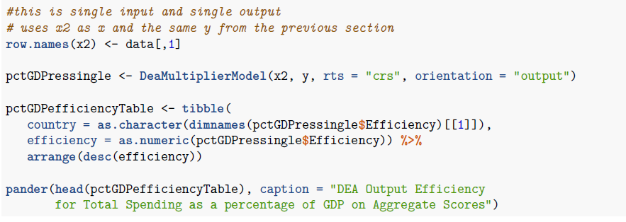
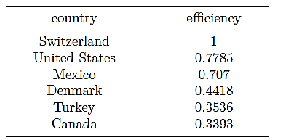
Efficiency as % GDP

Slide 20
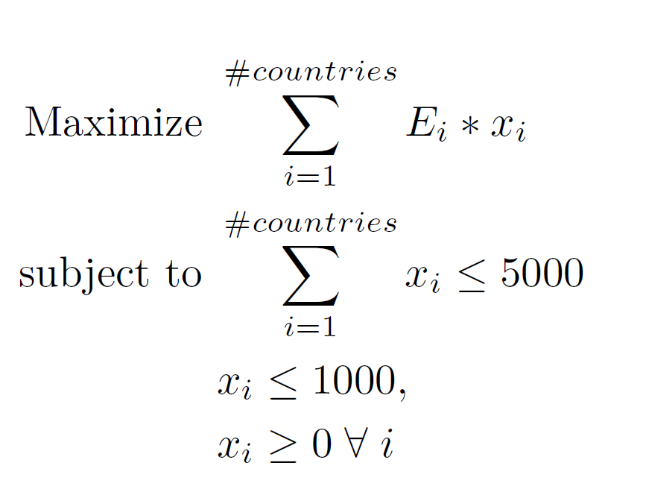
LP Model

Slide 21
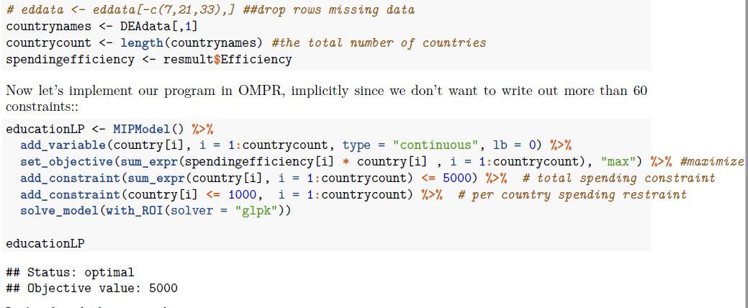
Implementing the model

Slide 22
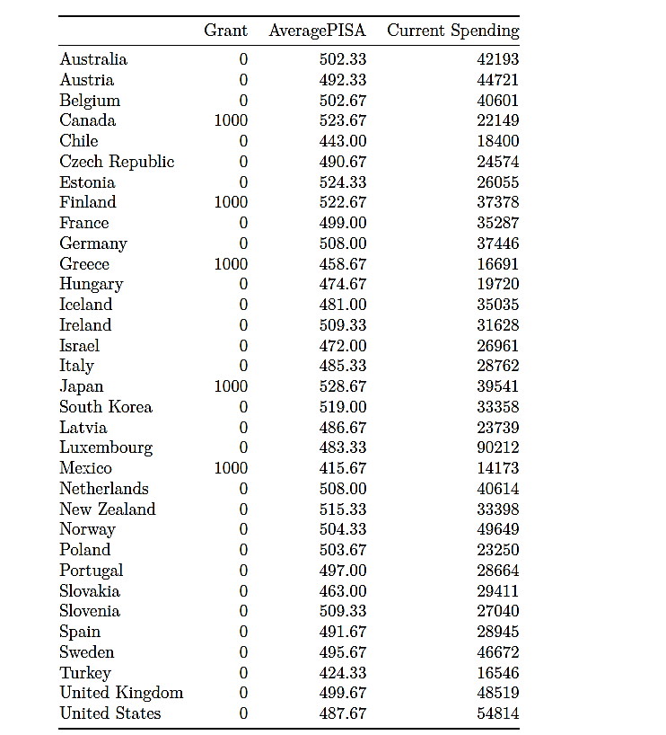

Slide 24
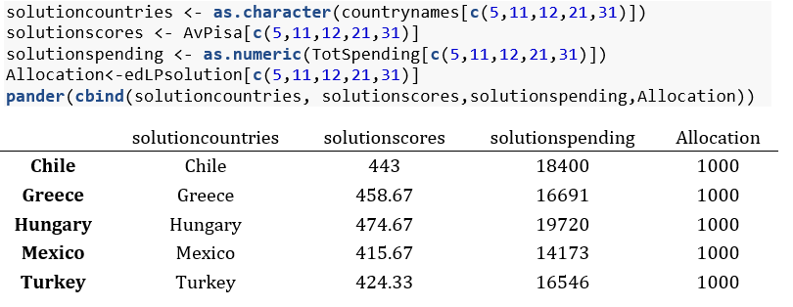

Slide 25
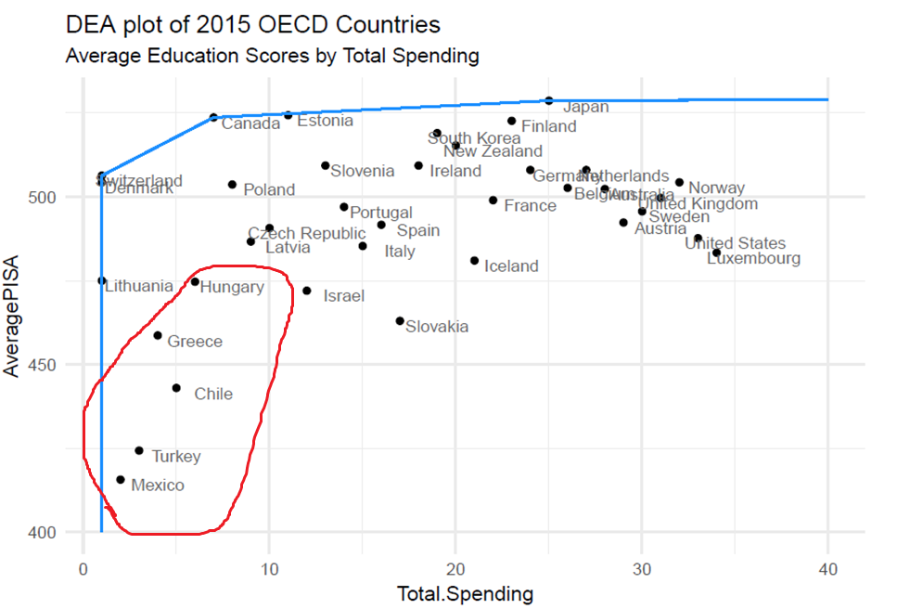

Slide 26
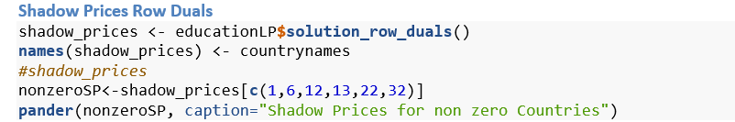
Shadow Prices

Slide 27
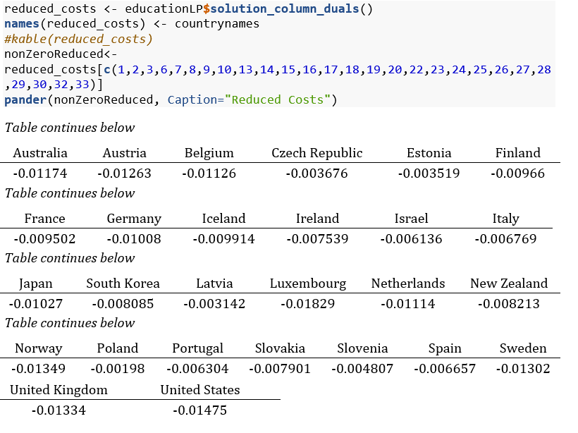
Reduced Costs

